Slide 1


Serving as the WSSA EPA Liaison:
My first impressions
Michael Barrett
Michael Barrett

Slide 2





The weeds WSSA!

Slide 3
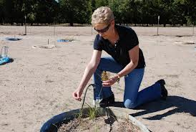
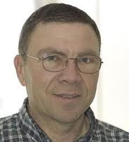
A little history on the Liaison position:
Steve Dewey first liaison, serving for 2 years 2007-2008)
Jill Schroeder served from 2009 -2013 (4.5 years)

Slide 4
Objectives of the Liaison Position:
For WSSA: To serve as a resource to EPA to help them make informed decisions, give them access to weed science information and expertise
For the EPA: To help them tell their story, how the Agency works, who they are, and how decisions are may
For both: Expose students and others to potential careers at the Agency

Slide 5
How does this work?
A three way partnership:
  Kentucky contributes 25% of my time (salary)
  WSSA provides for travel expenses
  EPA gives access, space to work, and provides for security clearance

Slide 6
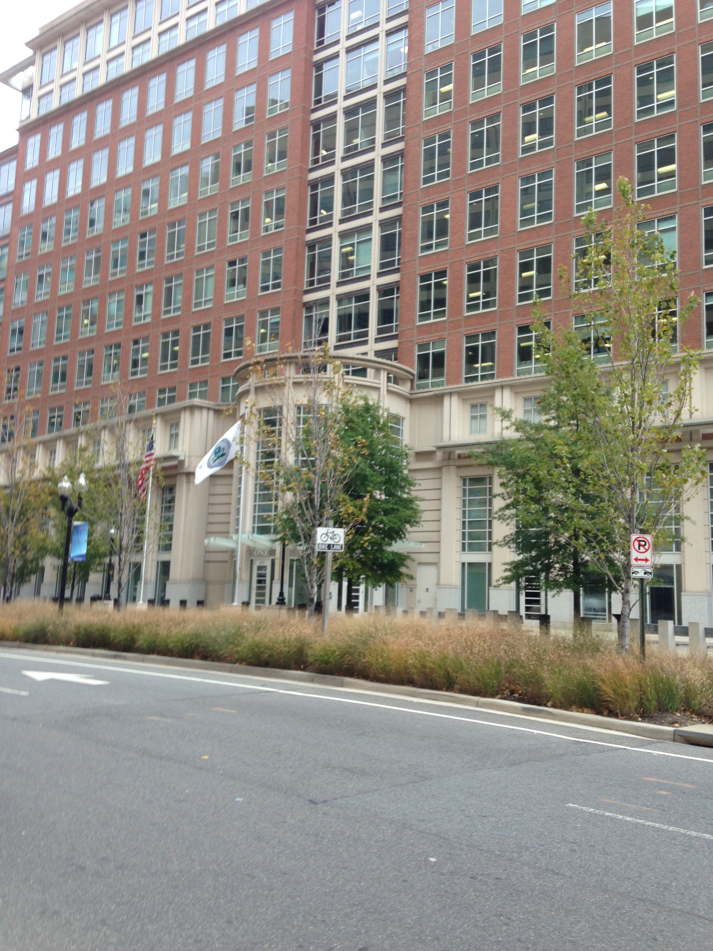

Some Nuts and Bolts
Where is the EPA?

Slide 7
Other details:
Go about once every 4-6 weeks
Arrive Wednesday leave Friday
When?
The EPA Staff work schedule:
  Many on a “compressed schedule”, off 1 day out of ten
  Others E-commute
  Monday and Friday light staffing but can be good for one-on-one meetings

Slide 8
Who do I work with?

Slide 9
Office of Pesticide Programs (OPP) Director – Steven Bradbury
Antimicrobial Division | Biological and Economic Assessment Division | Biopesticides and Pollution Prevention Division
Environmental Fate and Effects Division | Field and External Affairs Division | Health Effects Division
Information Technologies & Resources Management Division | Pesticide Re-Evaluation Division | Registration Division

Slide 10
OPP
Antimicrobial Division | Biological and Economic Assessment Division (BEAD) | Biopesticides and Pollution Prevention Division
Environmental Fate and Effects Division | Field and External Affairs Division | Health Effects Division
Information Technologies & Resources Management Division | Pesticide Re-Evaluation Division | Registration Division (RD)

Slide 11
BEAD
Skee Jones – Branch Chief
Bill Chism – Senior Biologist
Bill Phillips – Agronomist
Jonathan Becker – Senior Science Advisor

Slide 12
Registration Division
Dan Kenny – Branch Chief
Kay Montague and Bo Davis – Managers
8 Reviewers

Slide 13
How does it work?
Federal Insecticide, Fungicide and Rodenticide Act (FIFRA)
Rule Making
Internal policies – Voluntary requirements

Slide 14
How does it work?
Pesticide Registration Improvement Act (third version)

Slide 15
What do we discuss?

Slide 16
What we don’t talk about:
EPA Policy
Confidential Business Information (CBI)

Slide 17
Discussion topics:
Herbicide Resistance – by far the #1 topic!
  Meeting with Steve Bradbury
  Work with Resistance Management Team
    Common Resistance Terms List for all disciplines
  Attendance at WSSA Resistance Workshop
  Attendance at Economic Research Service Herbicide Resistance Meeting

Slide 18
Discussion topics:
National Pollution Discharge Elimination System (NPDES)
Plant Tech Team
IR4
GMOs/Selection for Naturally Occurring Herbicide Tolerance
Pesticide Problems
IPM

Slide 19
Some Impressions:
Very thin work force
  Very few reviewers
    Workforce reduced by 30-50%
  A large number of cases to consider
  Time pressure from PRIA

Slide 20
Some Impressions:
  Staff expertise is governed by who applies for the positions and federal hiring guidelines
  The most effective people balance science, policy and practicality in their decisions
  There is a continuing need for workforce development and training
  But, do they have the time?

Slide 21

Some Impressions:
Information from BEAD, EFED, HED
Decision by the Registration Division

Slide 22
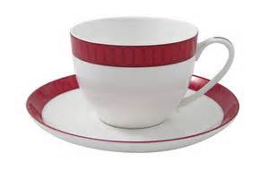
Some Impressions:
The “Risk Cup”

Slide 23
Some Impressions:
The job of OPP is to register pesticides
  Find ways to safely allow their use
  They make very conservative assessments
    The job is protect everyone

Slide 24
Some Impressions:
  Try to employ mitigation
    Models and tests can give good risk assessment estimates, but faulty inputs can inflate the risk estimate
    Are there measures, for example buffers or application technologies, than can reduce the risk?

Slide 25
Some Impressions:
This position, and really the work of Steve and Jill, has greatly raised the stature and visibility of weed science and the WSSA, not only at the EPA but also at other federal agencies like USDA Pest Management Policy

Slide 26
Some Impressions:
I have already been given incredible access – I have been invited to participate in many meetings and discussions plus the people I talk to have been very candid and open in our conversations

Slide 27
Some Impressions:
The Federal Government shutdown disrupted the work flow – they probably have not recovered from this yet

Slide 28
Looking Ahead
Need to connect with liaisons for Entomology (Mark Whalon, MSU) and Plant Pathology (still to be named)

Slide 29
Looking Ahead
The Registration Division is being reorganized
  It is certain that there will be some people with little to no weed science or herbicide background handling these registrations
  Need for basic weed science training, seminars, field experiences

Slide 30
Bottom Line
This has been a very worthwhile investment for WSSA and the challenge is to continue the great work of Steve and Jill.

Slide 31
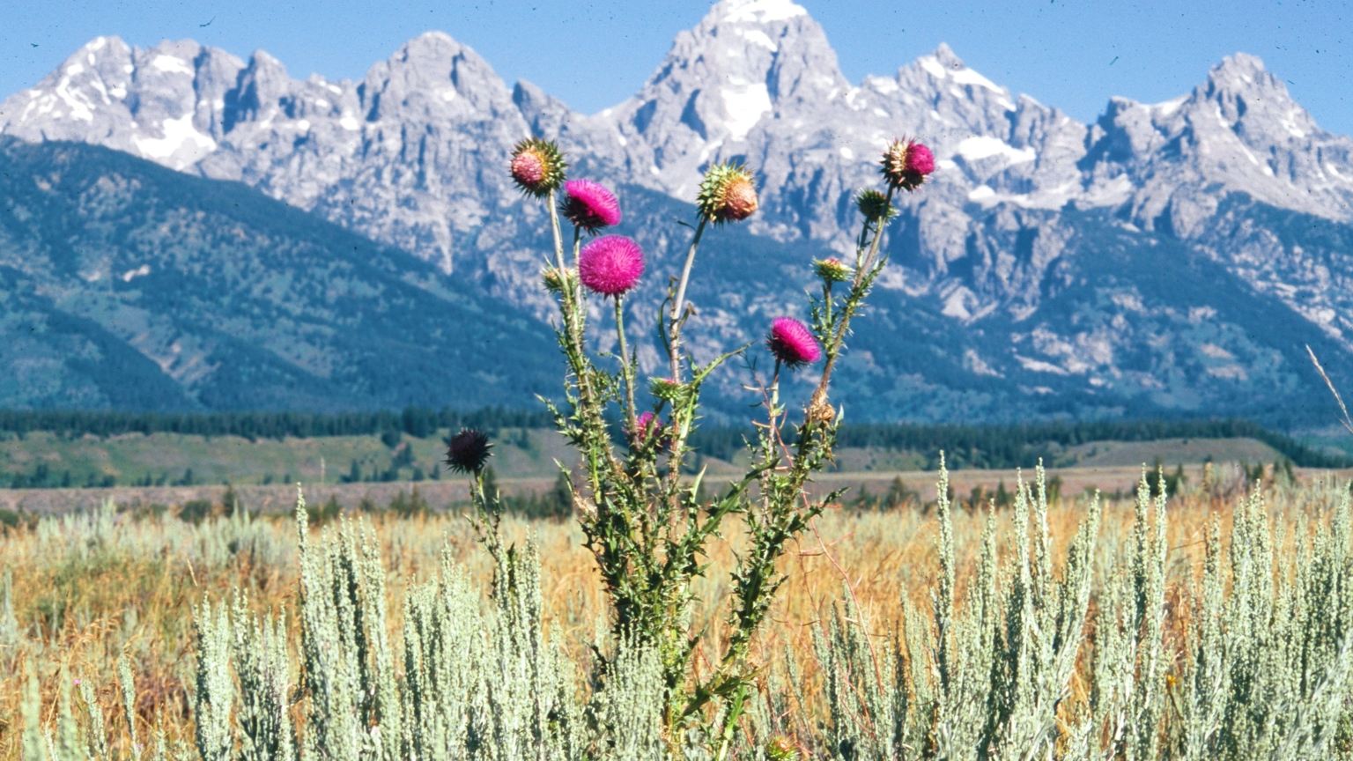
Questions?
Steve Dewey Photo

